Slide 1
Performance Management

Slide 2
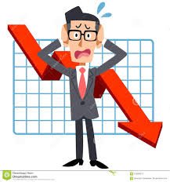

What is performance
Good Performance
Poor Performance

Slide 3
What is performance
What has been achieved?
How it has been achieved?

Slide 4
Performance Management
A process for establishing a shared understanding about what is to be achieved and how it is to be achieved, and an approach to managing people that increases the probability of achieving success.

Slide 5
Why to manage performance
Provide the basis for personal development
Align individual and organizational objectives
Develop a performance culture
Improve individual performance

Slide 6

PM Characteristics
Agreement
Measurement
Feedback
Dialogue
Reinforcement

Slide 7
PM Characteristics
It is not something that is done to people, is done for people and in partnership with them

Slide 8
PM Elements
Setting (SMART) Objectives
PDP
Annual Performance Review
Performance Appraisal
Performance Rating
Learning and Development
Performance related pay
360º feedback

Slide 9
SMART Objectives
S
M
A
S
T
Specific
Measurable
Attainable/ achievable
Realistic
Time-bound

Slide 10
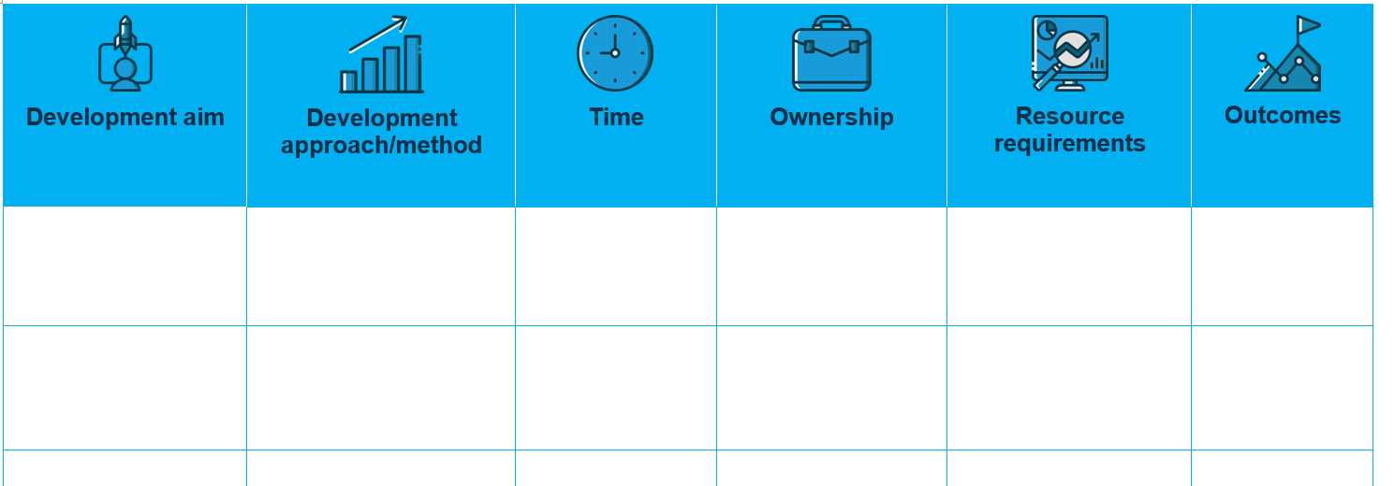
Personal Development Plan

Slide 11
AMO theory
Ability
Motivation
Opportunity

Slide 12
Motivation & PM
Boxall and Purcell (2003)
Ability
Motivation
OTP
Performance
AMO Formula

Slide 13
Motivation & PM
Siemsen, Roth, & Balasubramanian (2008)
Ability
Motivation
OTP
Performance
AMO Formula

Slide 14

Motivation
A motive is a reason for doing something

Slide 15
Motivation
التحفيز
Motivation
Intrinsic
Extrinsic

Slide 16
Motivation
Fredric Herzberg (1959)
Motivators
Demotivators

Slide 17
Motivation
Fredric Herzberg (1959)
Hygiene Factors
Company Policy & Administration.
Supervision.
Interpersonal relationships.
Working conditions.

Slide 18
Motivation
Fredric Herzberg (1959)
Motivational Factors
Achievement and recognition.
The work itself.
Advancement.
Personal Growth.

Slide 19
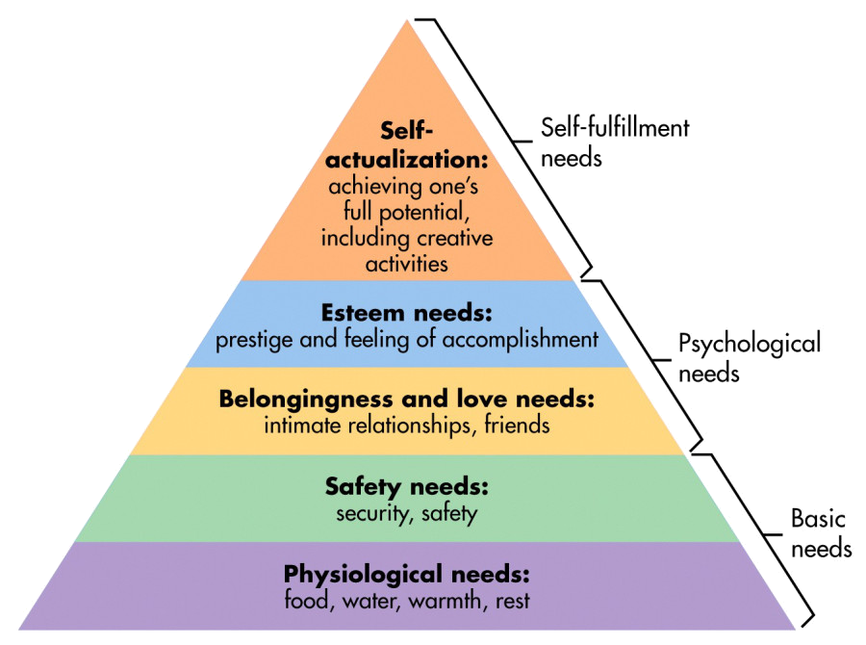
Motivation
Abraham Maslow(1943)

Slide 20
Motivation
Expectancy theory vroom (1964)
M = E * I * v
Expectancy
Instrumentality
Valence

Slide 21
Motivation
Daniel Pink (2009)
Autonomy
Purpose
Mastery

Slide 22
Competencies
KSA ?
CPD ?

Slide 23
Competencies
Knowledge
Skills
Attitude

Slide 24
JOHARI
Open
Blind
Hidden
Unknown
Known by others
Unknown by others
Known by self
Unknown by self

Slide 25
JOHARI
Open
Blind
Hidden
Unknown
Known by others
Unknown by others
Known by self
Unknown by self

Slide 26
JOHARI
Open
Blind
Hidden
Unknown
Known by others
Unknown by others
Known by self
Unknown by self

Slide 27

Reflection
consider how we do what we do, why we do it, how we feel about actions we’ve taken – and how all these elements might shape our future behavior

Slide 28

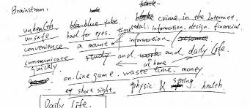
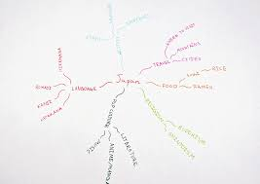
Reflection
Meditation, Exercise
Free Writing
Mind mapping

Slide 29
Reflection
Donald Schön (1983)
On action
In action
Before action
Reflection

Slide 30
Reflection
Terry Borton (1970)
What?
So what ?
Now what?

Slide 31

Reflection
Boud et al., (1985)
Re-evaluating the experience
Behaviors
Ideas
Feelings
New Perspectives

Slide 32
Individual Performance
الأداء الفردي
Motivation
Ability
OTP

Slide 33
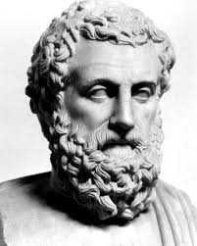
Quote
The roots of education are bitter, but the fruit is sweet (Aristotle)

Slide 34



